Slide 1


CSCE 5640 Operating System Design CPU Scheduling
Dr. Amar Maharjan
Computer Science and Engineering
University of North Texas
Slides (with some modifications) from:
Operating System Concepts 10th edition – Silberschatz, Galvin and Gagne © 2018
Notes:
Providing CPU resources to process or tasks(threads).

Slide 2
Outline
Basic Concepts
Scheduling Criteria
Scheduling Algorithms
Thread Scheduling
Multi-Processor Scheduling
Real-Time CPU Scheduling
Operating Systems Examples
Algorithm Evaluation

Slide 3
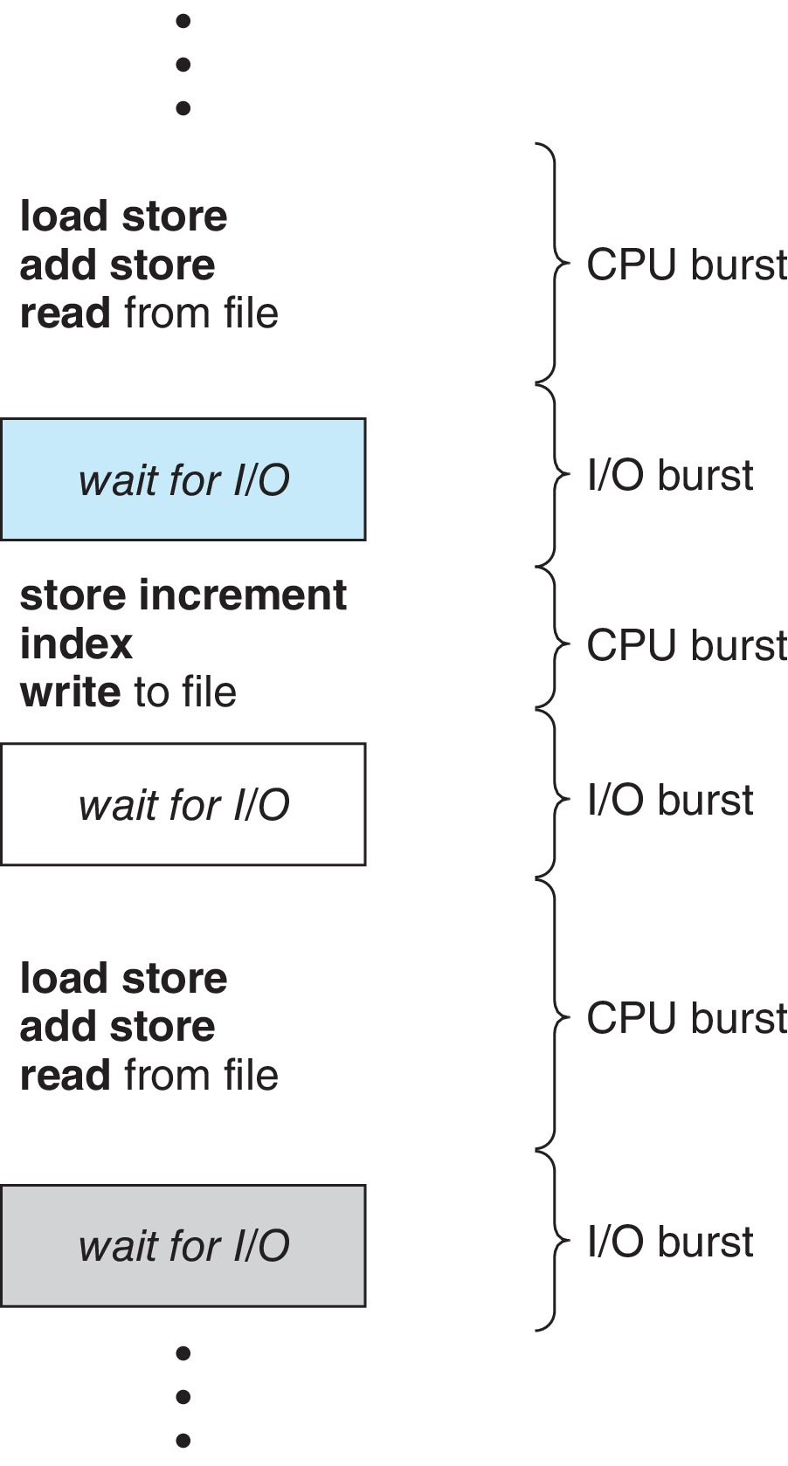
Basic Concepts
Maximum CPU utilization obtained with multiprogramming
CPU–I/O Burst Cycle – Process execution consists of a cycle of CPU execution and I/O wait
CPU burst followed by I/O burst
CPU burst distribution is of main concern
Notes:
Switch from thread to thread as soon as possible.
The right side cycle will execute continuously.

Slide 4
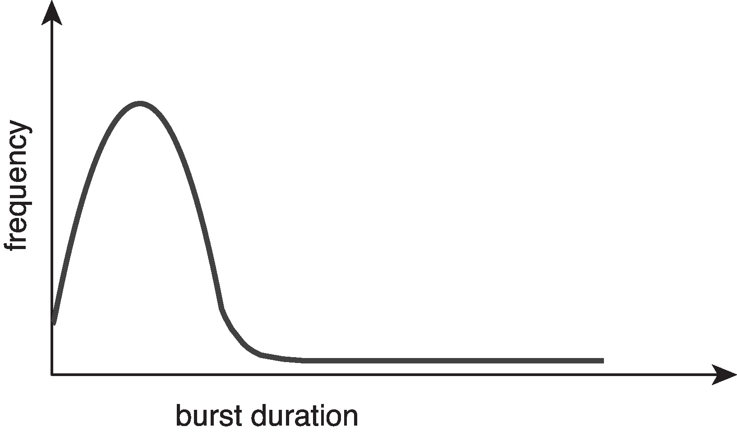
Histogram of CPU-burst Times
Large number of short bursts
Small number of longer bursts
Notes:
There will be multiple IO requests, so you need to switch between threads very quickly to increase efficiency.

Slide 5
CPU Scheduler
The CPU scheduler selects from among the processes in ready queue, and allocates a CPU core to one of them
Queue may be ordered in various ways
CPU scheduling decisions may take place when a process:
1. Switches from running to waiting state
2. Switches from running to ready state
3. Switches from waiting to ready state
Terminates
For situations 1 and 4, there is no choice in terms of scheduling. A new process (if one exists in the ready queue) must be selected for execution.
For situations 2 and 3, however, there is a choice.
Notes:
This is a functionality to switch between processes.
Picks the process from the ready queue (May not be FIFO; it’s a general term)
If the process is running and exceeds the threshold, this process will move to a ready state, and another process will be picked from the ready state.

Slide 6
Preemptive and Nonpreemptive Scheduling
When scheduling takes place only under circumstances 1 and 4, the scheduling scheme is nonpreemptive.
Otherwise, it is preemptive.
Under Nonpreemptive scheduling
once the CPU has been allocated to a process, the process keeps the CPU until it releases it either by terminating or by switching to the waiting state.
Virtually all modern operating systems including Windows, MacOS, Linux, and UNIX use preemptive scheduling algorithms.
Notes:
Preempt is kind of stopping.

Slide 7
Preemptive Scheduling and Race Conditions
Preemptive scheduling can result in race conditions when data are shared among several processes.
Consider the case of two processes that share data.
While one process is updating the data, it is preempted so that the second process can run.
The second process then tries to read the data, which are in an inconsistent state.
This issue will be explored in detail in Chapter 6.
Notes:
Generally windows, Mac all use preemptive scheduling.

Slide 8
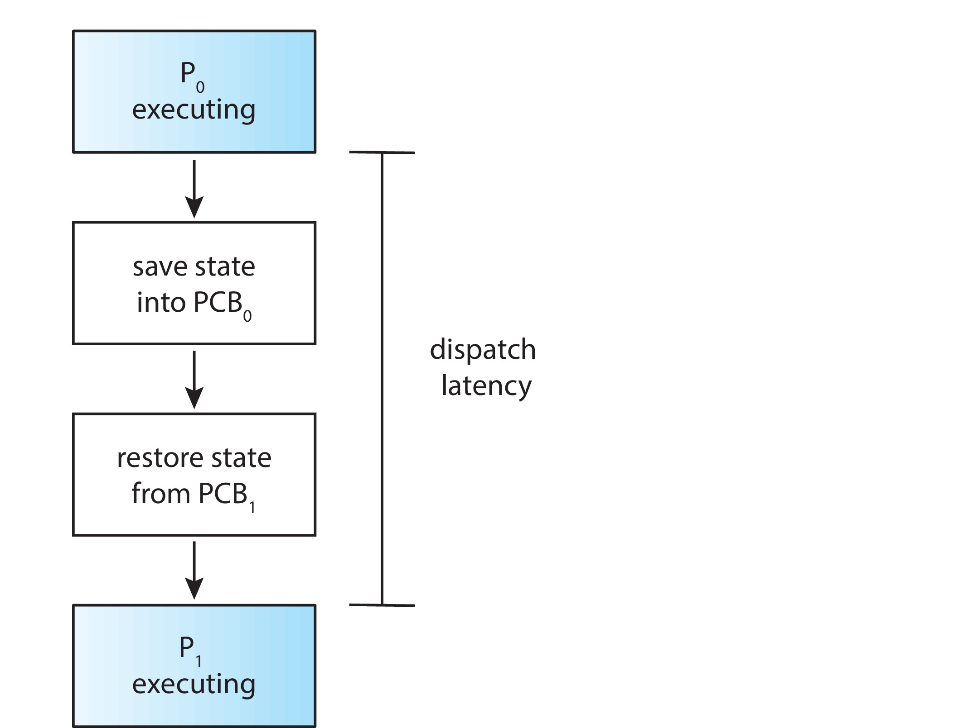
Dispatcher
Dispatcher module gives control of the CPU to the process selected by the CPU scheduler; this involves:
Switching context
Switching to user mode
Jumping to the proper location in the user program to restart that program
Dispatch latency – time it takes for the dispatcher to stop one process and start another running
Notes:
The number of context switches can be obtained by using the vmstat command that is available on Linux systems.
$ vmstat 1 3
------cpu-----
24
225
339
The first line gives the average number of context switches over 1 second since the system booted, and the next two lines give the number of context switches over two 1-second intervals.
$ cat /proc/2166/status
CPU schedular selects the process from the ready queue and the dispatcher will dispatch.
Move from one content to another context the middle time is dispatch latency. It is better if the latency is low.

Slide 9
Scheduling Criteria
CPU utilization – keep the CPU as busy as possible
Throughput – # of processes that complete their execution per time unit
Turnaround time – amount of time to execute a particular process
Waiting time – amount of time a process has been waiting in the ready queue
Response time – amount of time it takes from when a request was submitted until the first response is produced.
Optimization criteria
Max CPU utilization, Max throughput
Min turnaround time, Min waiting time, Min response time
Notes:
Per unit can be our definition. One unit can be 5 minutes also.
We want to reduce waiting time.
The response could be the first output. Reduce the response time.

Slide 10
Scheduling Algorithms
CPU scheduling deals with the problem of deciding which of the processes in the ready queue is to be allocated the CPU’s core.
Context of the scheduling algorithms: a single CPU with only one processing core available.
Algorithms
First-Come, First-Served Scheduling
Shortest-Job-First Scheduling
Round-Robin Scheduling
Priority Scheduling
Multilevel Queue Scheduling
Multilevel Feedback Queue Scheduling

Slide 11
First- Come, First-Served (FCFS) Scheduling
Process Burst Time
P₁ 24
P₂ 3
P₃ 3
Suppose that the processes arrive in the order: P₁ , P₂ , P₃ The Gantt Chart for the schedule is:
Waiting time for P₁ = 0; P₂ = 24; P₃ = 27
Average waiting time: (0 + 24 + 27)/3 = 17

Slide 12
FCFS Scheduling (contd.)
Suppose that the processes arrive in the order:
P₂ , P₃ , P₁
The Gantt chart for the schedule is:
Waiting time for P₁ = 6; P₂ = 0; P₃ = 3
Average waiting time: (6 + 0 + 3)/3 = 3
Much better than previous case
Convoy effect - short process behind long process
Consider one CPU-bound and many I/O-bound processes
Notes:
Easy to implement, but not the best result.

Slide 13
Shortest-Job-First (SJF) Scheduling
Associate with each process the length of its next CPU burst
Use these lengths to schedule the process with the shortest time
SJF is optimal – gives minimum average waiting time for a given set of processes
Preemptive version called shortest-remaining-time-first
How do we determine the length of the next CPU burst?
Could ask the user
Estimate
Notes:
This is a non-preemptive version: If we pick the process, we need to execute it.

Slide 14
Example of SJF
Process Burst Time
P₁ 6
P₂ 8
P₃ 7
P₄ 3
SJF scheduling chart
Average waiting time = (3 + 16 + 9 + 0) / 4 = 7

Slide 15
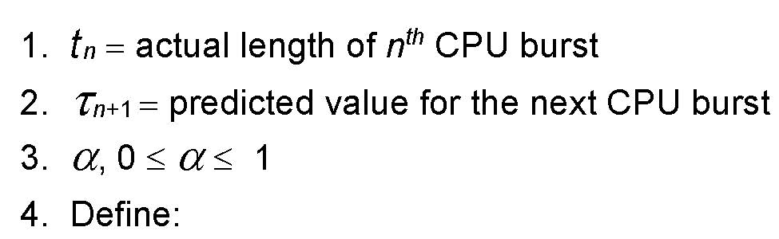

Determining Length of Next CPU Burst
Can only estimate the length – should be similar to the previous one
Then pick process with shortest predicted next CPU burst
Can be done by using the length of previous CPU bursts, using exponential averaging
Commonly, α set to ½
Notes:
Tau n+1: In the future
Alpha is the weight/percentage value.
Tau n: Is the previously predicted value in the previous CPU cycle.

Slide 16
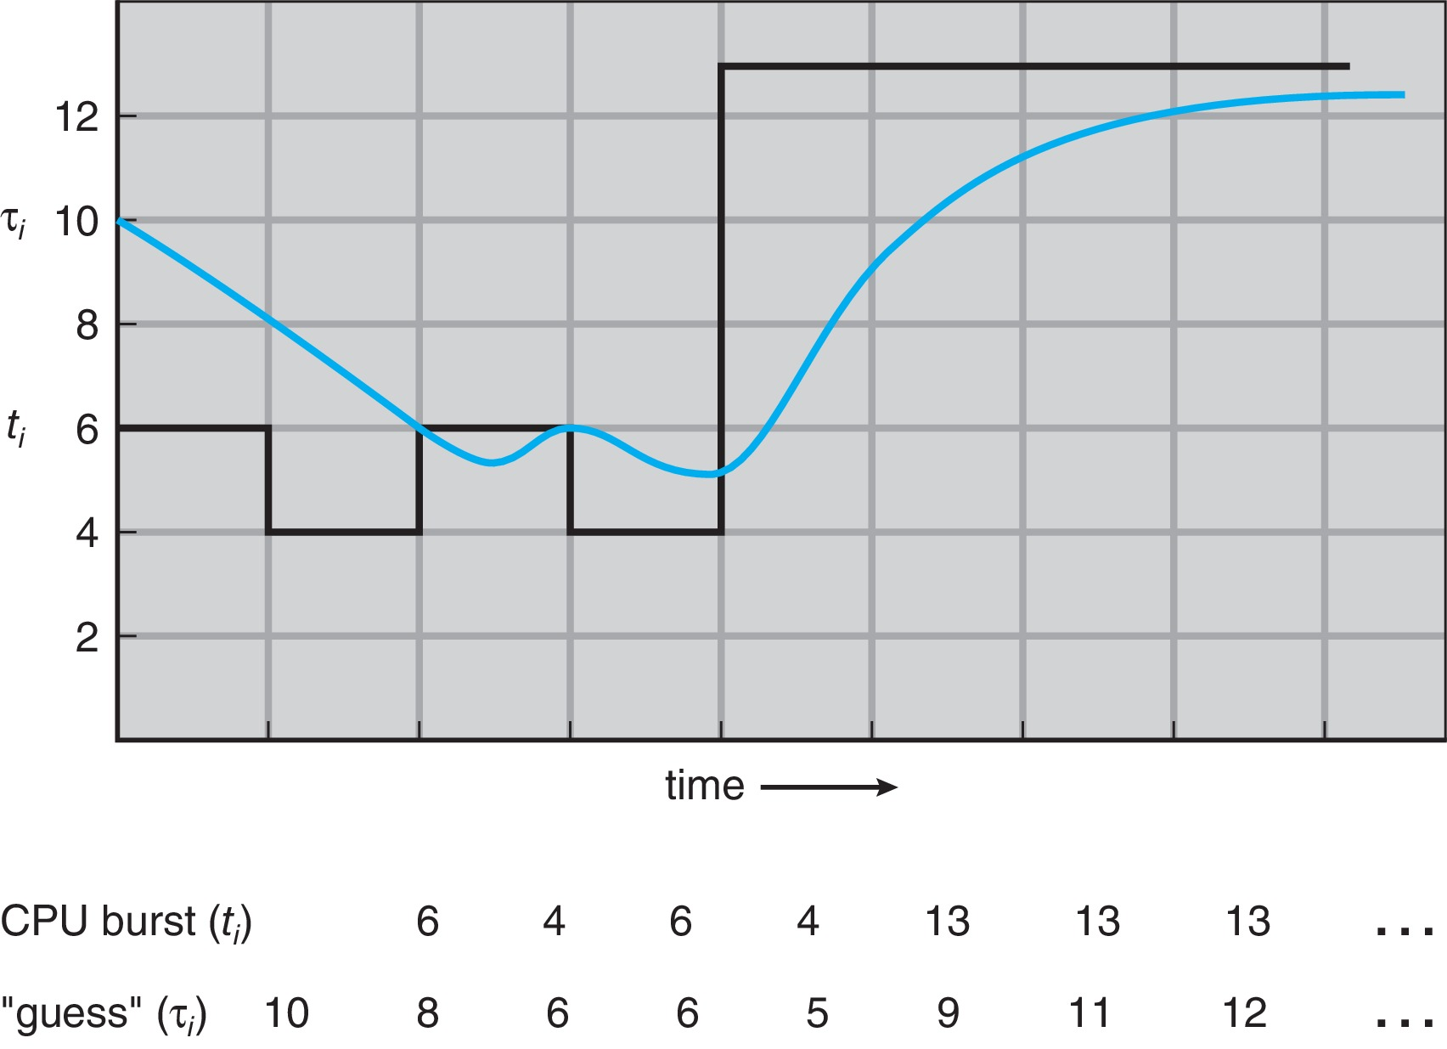
Prediction of the Length of the Next CPU Burst
Notes:
The blue line is predicted.
The black line is the actual values.
= 0.5*6 + 0.5*10 = 8
Assumed alpha is 0.5
Predicted values will be a smooth transition.

Slide 17
Examples of Exponential Averaging
α =0
τ_{n+1} = τ_{n}
Recent history does not count
α =1
τ_{n+1} = α t_{n}
Only the actual last CPU burst counts
If we expand the formula, we get:
τ_{n+1} = α t_{n}+(1 - α)α t_{n-1} + … + (1 - α )^{j} α t_{n-j} + … + (1 - α )^{n +1} τ₀
Since both α and (1 - α) are less than or equal to 1, each successor term has less weight than its predecessor

Slide 18
Shortest Remaining Time First Scheduling
Preemptive version of SJF
Whenever a new process arrives in the ready queue, the decision on which process to schedule next is redone using the SJF algorithm.
Is SRT more “optimal” than SJF in terms of the minimum average waiting time for a given set of processes?
Notes:
Ans: Yes, it is more optimal.

Slide 19
Example of Shortest-remaining-time-first
Now we add the concepts of varying arrival times and preemption to the analysis
Process i Arrival Time Burst Time
P₁ 0 8
P₂ 1 4
P₃ 2 9
P₄ 3 5
Preemptive SJF Gantt Chart
Average waiting time = [(10-1)+(1-1)+(17-2)+(5-3)]/4 = 26/4 = 6.5

Slide 20
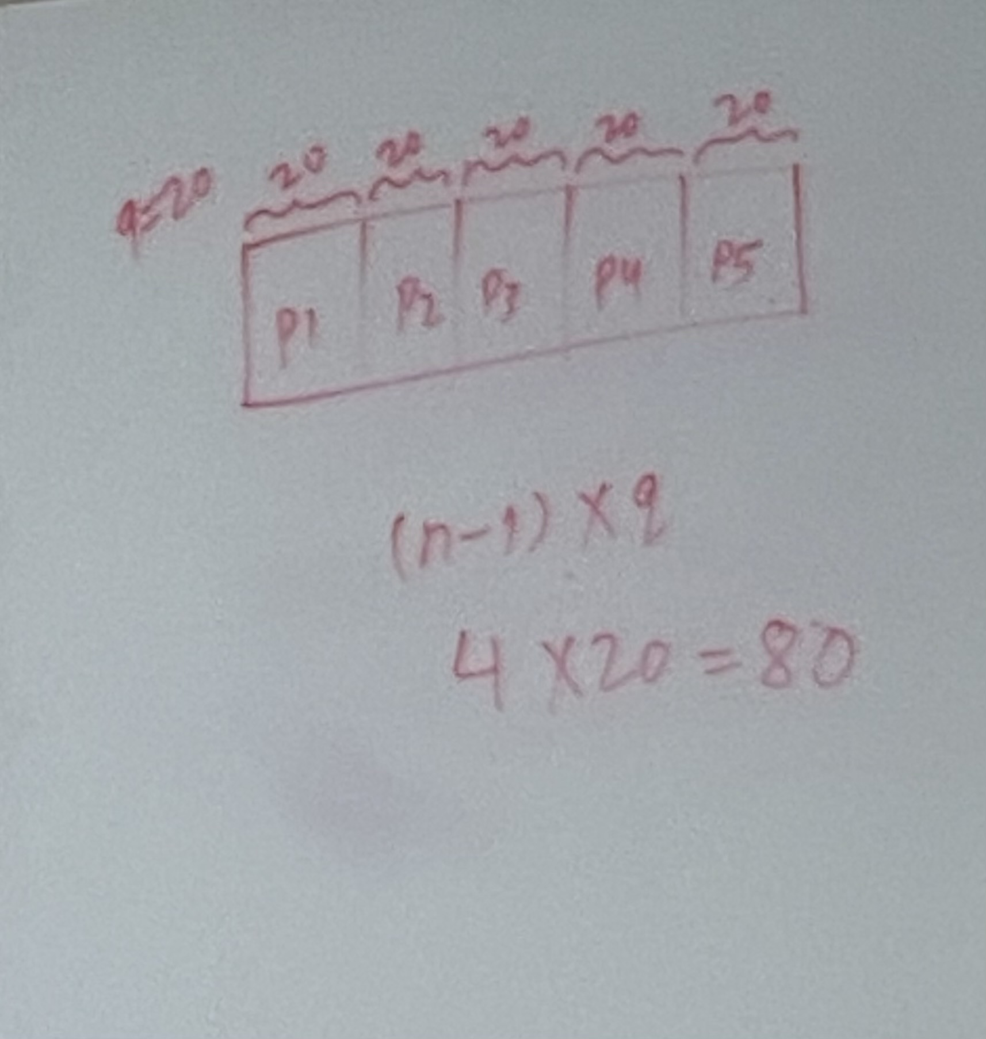
Round Robin (RR)
Each process gets a small unit of CPU time (time quantum q), usually 10-100 milliseconds.
After this time has elapsed, the process is preempted and added to the end of the ready queue.
If there are n processes in the ready queue and the time quantum is q, then each process gets 1/n of the CPU time in chunks of at most q time units at once.
No process waits more than (n-1)q time units.
For example, with five processes and a time quantum of 20 milliseconds, each process will get up to 20 milliseconds every 100 milliseconds.
Timer interrupts every quantum to schedule next process
Performance
q large ⇒ FIFO (FCFS)
q small ⇒ RR
Note that q must be large with respect to context switch, otherwise overhead is too high.
Notes:
Circularly providing CPU so that each process is given unit time.
Select q properly.
Q must be large with respect to context switching. Otherwise, you are wasting more time in switching the context.

Slide 21
Example of RR with Time Quantum = 4
Process Burst Time
P₁ 24
P₂ 3
P₃ 3
The Gantt chart is:
Typically, higher average turnaround than SJF, but better response
q should be large compared to context switch time
q usually 10 milliseconds to 100 milliseconds,
Context switch < 10 microseconds
Notes:
Between because every process is getting it.
If we use response time, this algorithm will perform better.

Slide 22
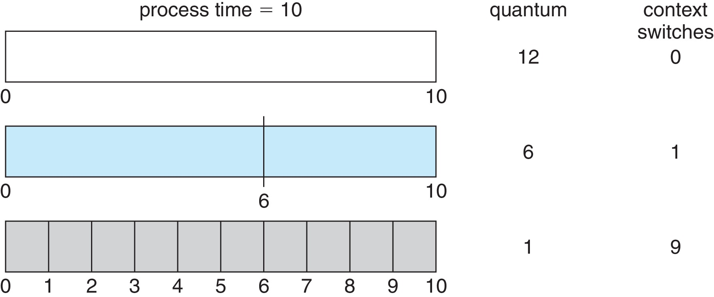
Time Quantum and Context Switch Time
Notes:
According to research, more context is not always better.

Slide 23
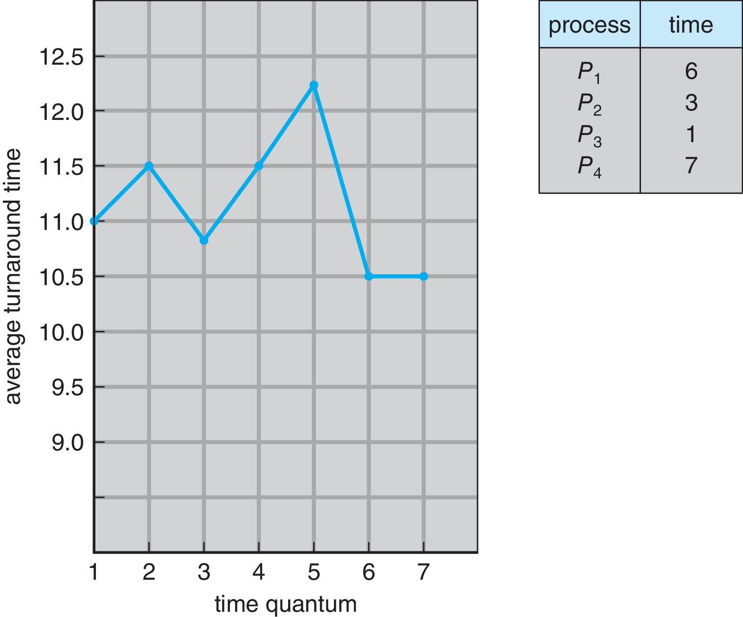
Turnaround Time Varies With The Time Quantum
Rule of thumb: 80% of CPU bursts should be shorter than the time quantum.
Notes:
Turnaround time: Time to complete a task.
As we increase the quantum from 5 to 6, the turnaround time decreases, So increasing the time quantum is not always efficient.

Slide 24
Priority Scheduling
A priority number (integer) is associated with each process
The CPU is allocated to the process with the highest priority (smallest integer ≡ highest priority)
Preemptive
Nonpreemptive
SJF is priority scheduling where priority is the inverse of predicted next CPU burst time
Problem ≡ Starvation – low priority processes may never execute
Solution ≡ Aging – as time progresses increase the priority of the process
Notes:
High priority will get more CPU time.
The lower the number, the higher the priority.

Slide 25
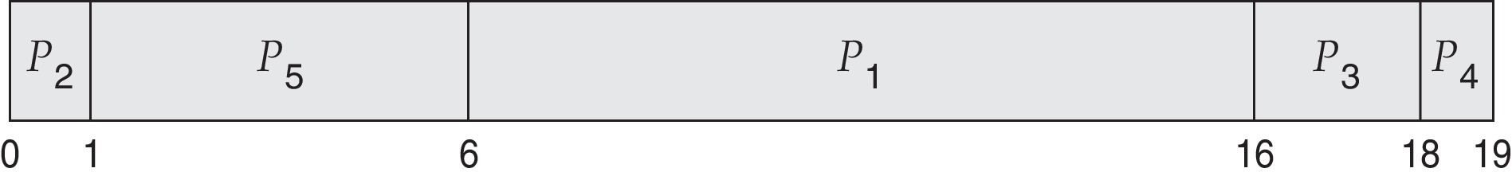
Example of Priority Scheduling
Process Burst Time Priority
P₁ 10 3
P₂ 1 1
P₃ 2 4
P₄ 1 5
P₅ 5 2
Priority scheduling Gantt Chart
Average waiting time = 8.2
Notes:
(6+0+16+18+1)/5 = 41/5 = 8.2

Slide 26
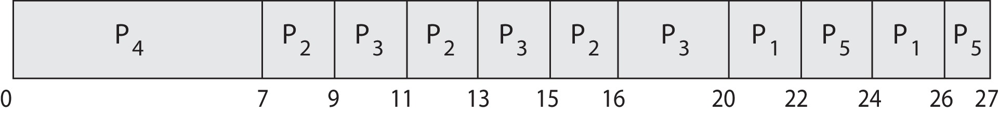
Priority Scheduling w/ Round-Robin
Run the process with the highest priority. Processes with the same priority run round-robin
Example:
Process a Burst Time Priority
P₁ 4 3
P₂ 5 2
P₃ 8 2
P₄ 7 1
P₅ 3 3
Gantt Chart with time quantum = 2
Notes:
Priority of P2 and P3 are the same, so for those two, we use round robin.
Also P1 and P5.
Homework: Avg waiting time = 13.8

Slide 27
Multilevel Queue
The ready queue consists of multiple queues
Multilevel queue scheduler defined by the following parameters:
Number of queues
Scheduling algorithms for each queue
Foreground queue uses an RR algorithm while the background queue uses an FCFS algorithm.
Scheduling among the queues
In foreground-background queue,
The foreground queue can be given 80% of the CPU time for RR scheduling among its process.
The background queue receives 20% of the CPU to give to its processes on an FCFC basis.
Notes:
These 2 are theoretical.
N number of queues, and each queue follows different scheduling.
Foreground: User side.

Slide 28
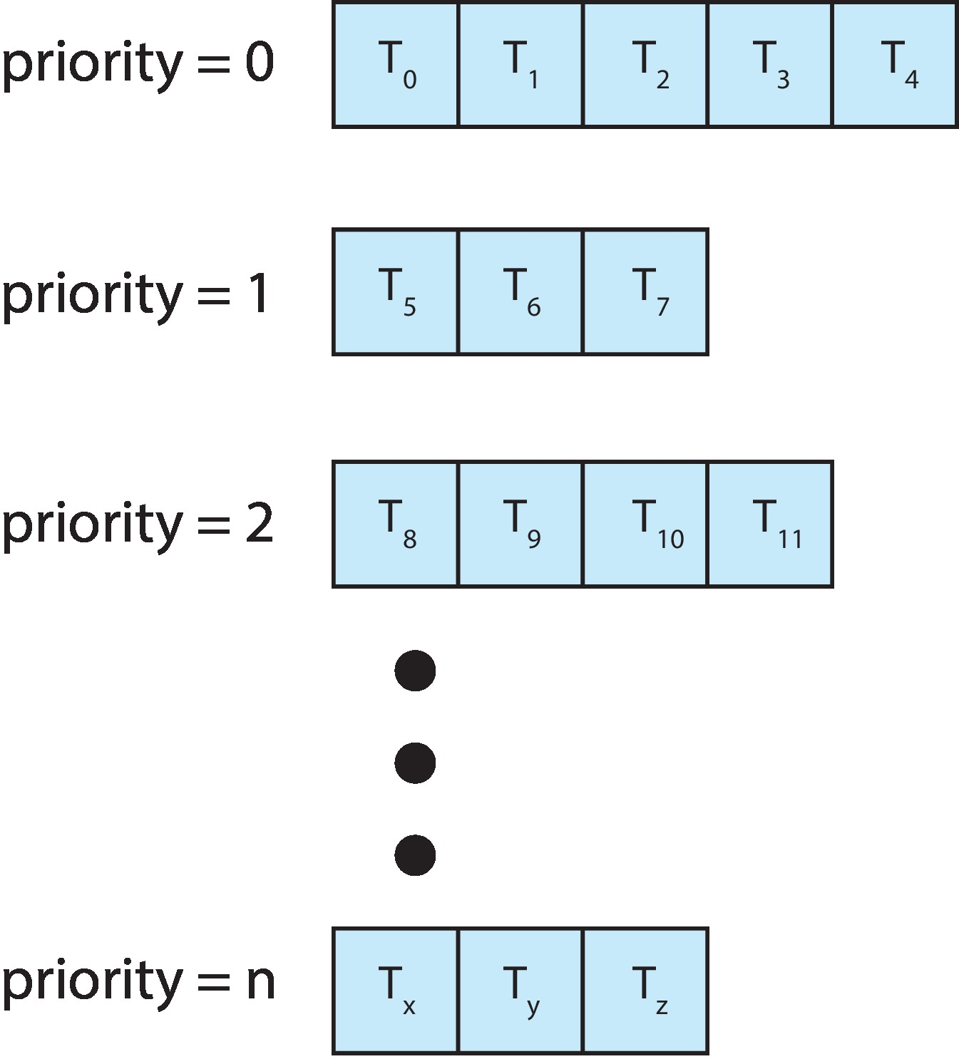
Multilevel Queue
With priority scheduling, have separate queues for each priority.
Schedule the process in the highest-priority queue!
Notes:
If we have a task in priority 0, we execute else we jump to a lower priority queue.

Slide 29
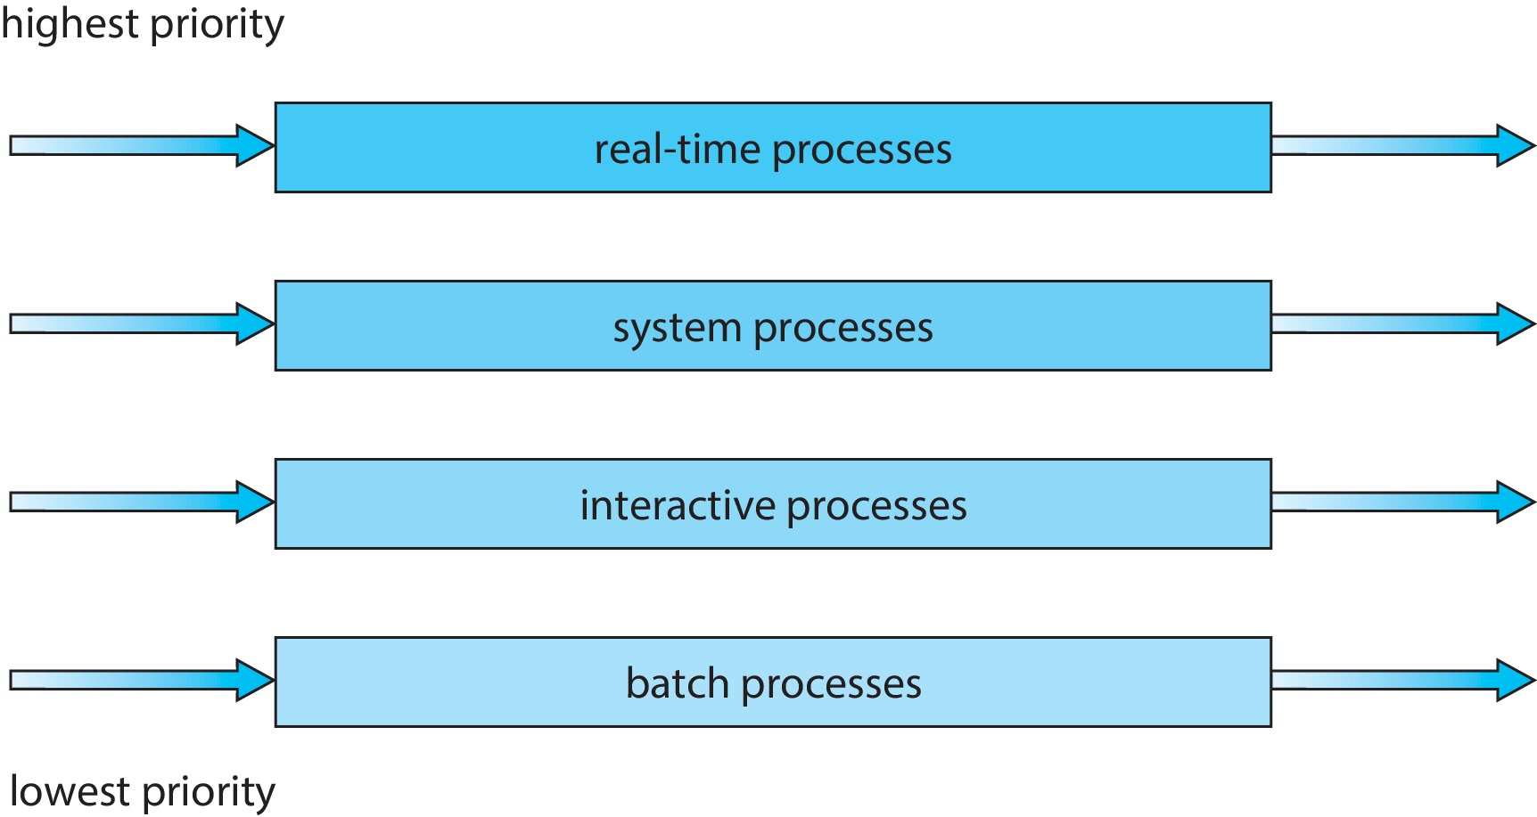
Multilevel Queue
Prioritization based upon process type
Notes:
Drawback: If we keep on adding the process in the top layer, the lower layer may be waiting forever.

Slide 30
Multilevel Feedback Queue
A process can move between the various queues.
Multilevel-feedback-queue scheduler defined by the following parameters:
Number of queues
Scheduling algorithms for each queue
Method used to determine when to upgrade a process
Method used to determine when to demote a process
Method used to determine which queue a process will enter when that process needs service
Aging can be implemented using multilevel feedback queue
Notes:
The process can jump from one queue to another dynamically.

Slide 31
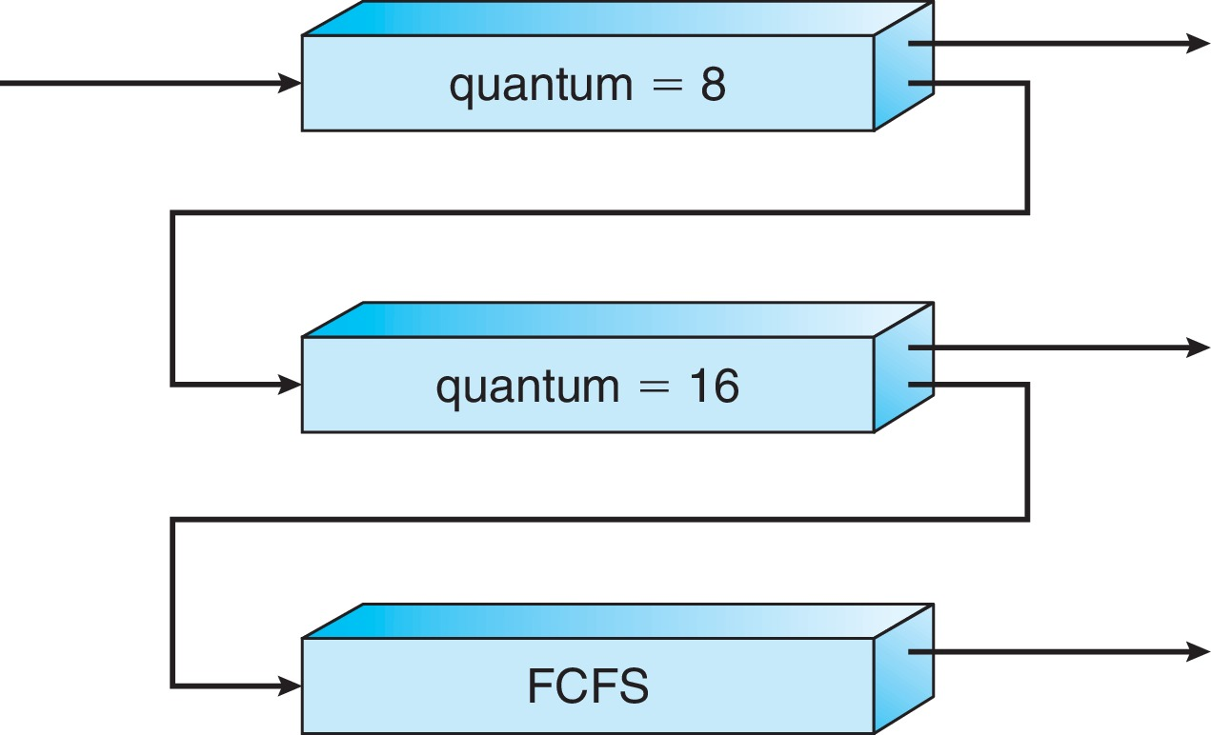
Example of Multilevel Feedback Queue
Three queues:
Q₀ – RR with time quantum 8 milliseconds
Q₁ – RR with time quantum 16 milliseconds
Q₂ – FCFS
Scheduling
A new process enters queue Q₀ which is served in RR
When it gains CPU, the process receives 8 milliseconds
If it does not finish in 8 milliseconds, the process is moved to queue Q₁
At Q₁ job is again served in RR and receives 16 additional milliseconds
If it still does not complete, it is preempted and moved to queue Q₂
Notes:
We put a new process in top priority. If it is completed within the quantum time, then fine else it is demoted to the below queue. And so on.

Slide 32
Thread Scheduling
Distinction between user-level and kernel-level threads
When threads supported, threads scheduled, not processes
Many-to-one and many-to-many models, thread library schedules user-level threads to run on LWP
Known as process-contention scope (PCS) since scheduling competition is within the process
Typically done via priority set by programmer
Kernel thread scheduled onto available CPU is system-contention scope (SCS) – competition among all threads in system
Notes:
Scheduling in user space is much easier than in kernel space.
The decision of which thread to choose is done in the user space. → PCS (Processes are competing to get the thread in the user space)
And if kernel decided, then → SCS. (Processes are competing to get the thread in the kernel)
Usually, one-to-one mapping is done in the kernel space.

Slide 33
Pthread Scheduling
API allows specifying either PCS or SCS during thread creation
PTHREAD_SCOPE_PROCESS schedules threads using PCS scheduling
PTHREAD_SCOPE_SYSTEM schedules threads using SCS scheduling
Can be limited by OS – Linux and macOS only allow PTHREAD_SCOPE_SYSTEM
Notes:
In Linux and Mac, it uses one-to-one mapping.

Slide 34
Pthread Scheduling API
#include <pthread.h>
#include <stdio.h>
#define NUM_THREADS 5
int main(int argc, char *argv[]) {
int i, scope; pthread_t tid[NUM THREADS];
pthread_attr_t attr;
/* get the default attributes */
pthread_attr_init(&attr);
/* first inquire on the current scope */ if (pthread_attr_getscope(&attr, &scope) != 0)
fprintf(stderr, "Unable to get scheduling scope\n");
else {
if (scope == PTHREAD_SCOPE_PROCESS)
printf("PTHREAD_SCOPE_PROCESS");
else if (scope == PTHREAD_SCOPE_SYSTEM)
printf("PTHREAD_SCOPE_SYSTEM");
else fprintf(stderr, "Illegal scope value.\n");
}
/* set the scheduling algorithm to PCS or SCS */
pthread_attr_setscope(&attr, PTHREAD_SCOPE_SYSTEM);
/* create the threads */ for (i = 0; i < NUM_THREADS; i++)
pthread_create(&tid[i],&attr,runner,NULL);
/* now join on each thread */ for (i = 0; i < NUM_THREADS; i++)
pthread_join(tid[i], NULL);
}
/* Each thread will begin control in this function */
void *runner(void *param) {
/* do some work ... */
pthread_exit(0);
}
Notes:
If pthread_attr_getscope returns 0, then it worked fine.
Pthread_join in for loop is important because the parent thread will wait for all the children to execute.
The runner function will execute a number of times, the same as the number of threads.
Uppercase variable are constant values.
gcc posix-sched.c -lpthread

Slide 35
Multiple-Processor Scheduling
CPU scheduling becomes more complex when multiple CPUs are available
Multiprocess may be any one of the following architectures:
Multicore CPUs
Multithreaded cores
NUMA systems
Heterogeneous multiprocessing
Notes:
NUMA: Non-uniform memory access.
Heterogeneous: Not similar.

Slide 36
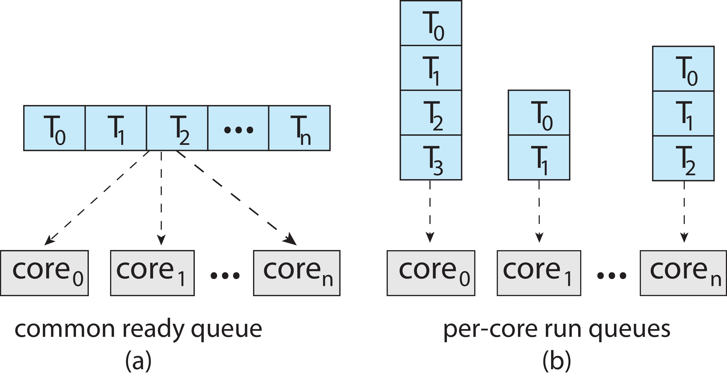
Multiple-Processor Scheduling
Symmetric multiprocessing (SMP) is where each processor is self scheduling.
Strategies
All threads may be in a common ready queue (a)
Each processor may have its own private queue of threads (b)
Notes:
ISSUE:
Blue box: Ready queue
There must be synchronization in the image (a). - One is reading, and one is writing.
Image (b): No need for synchronization because each process has its own ready queue.

Slide 37
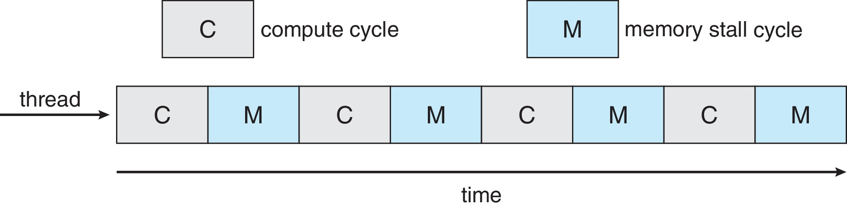
Multicore Processors
Recent trend to place multiple processor cores on same physical chip
Faster and consumes less power
Multiple threads per core also growing
Takes advantage of memory stall to make progress on another thread while memory retrieve happens
Notes:
ISSUE:
This cycle will happen in a real-world scenario.
This cycle will repeat continuously.
During the memory stall cycle, can the CPU switch to another thread?

Slide 38
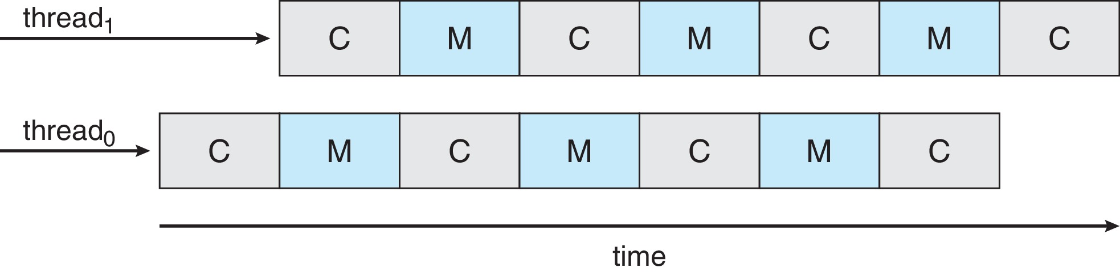
Multithreaded Multicore System
Each core has > 1 hardware threads.
If one thread has a memory stall, switch to another thread!
Notes:
If there is a memory stall, the CPU can switch to another thread. This way, we can take advantage.

Slide 39
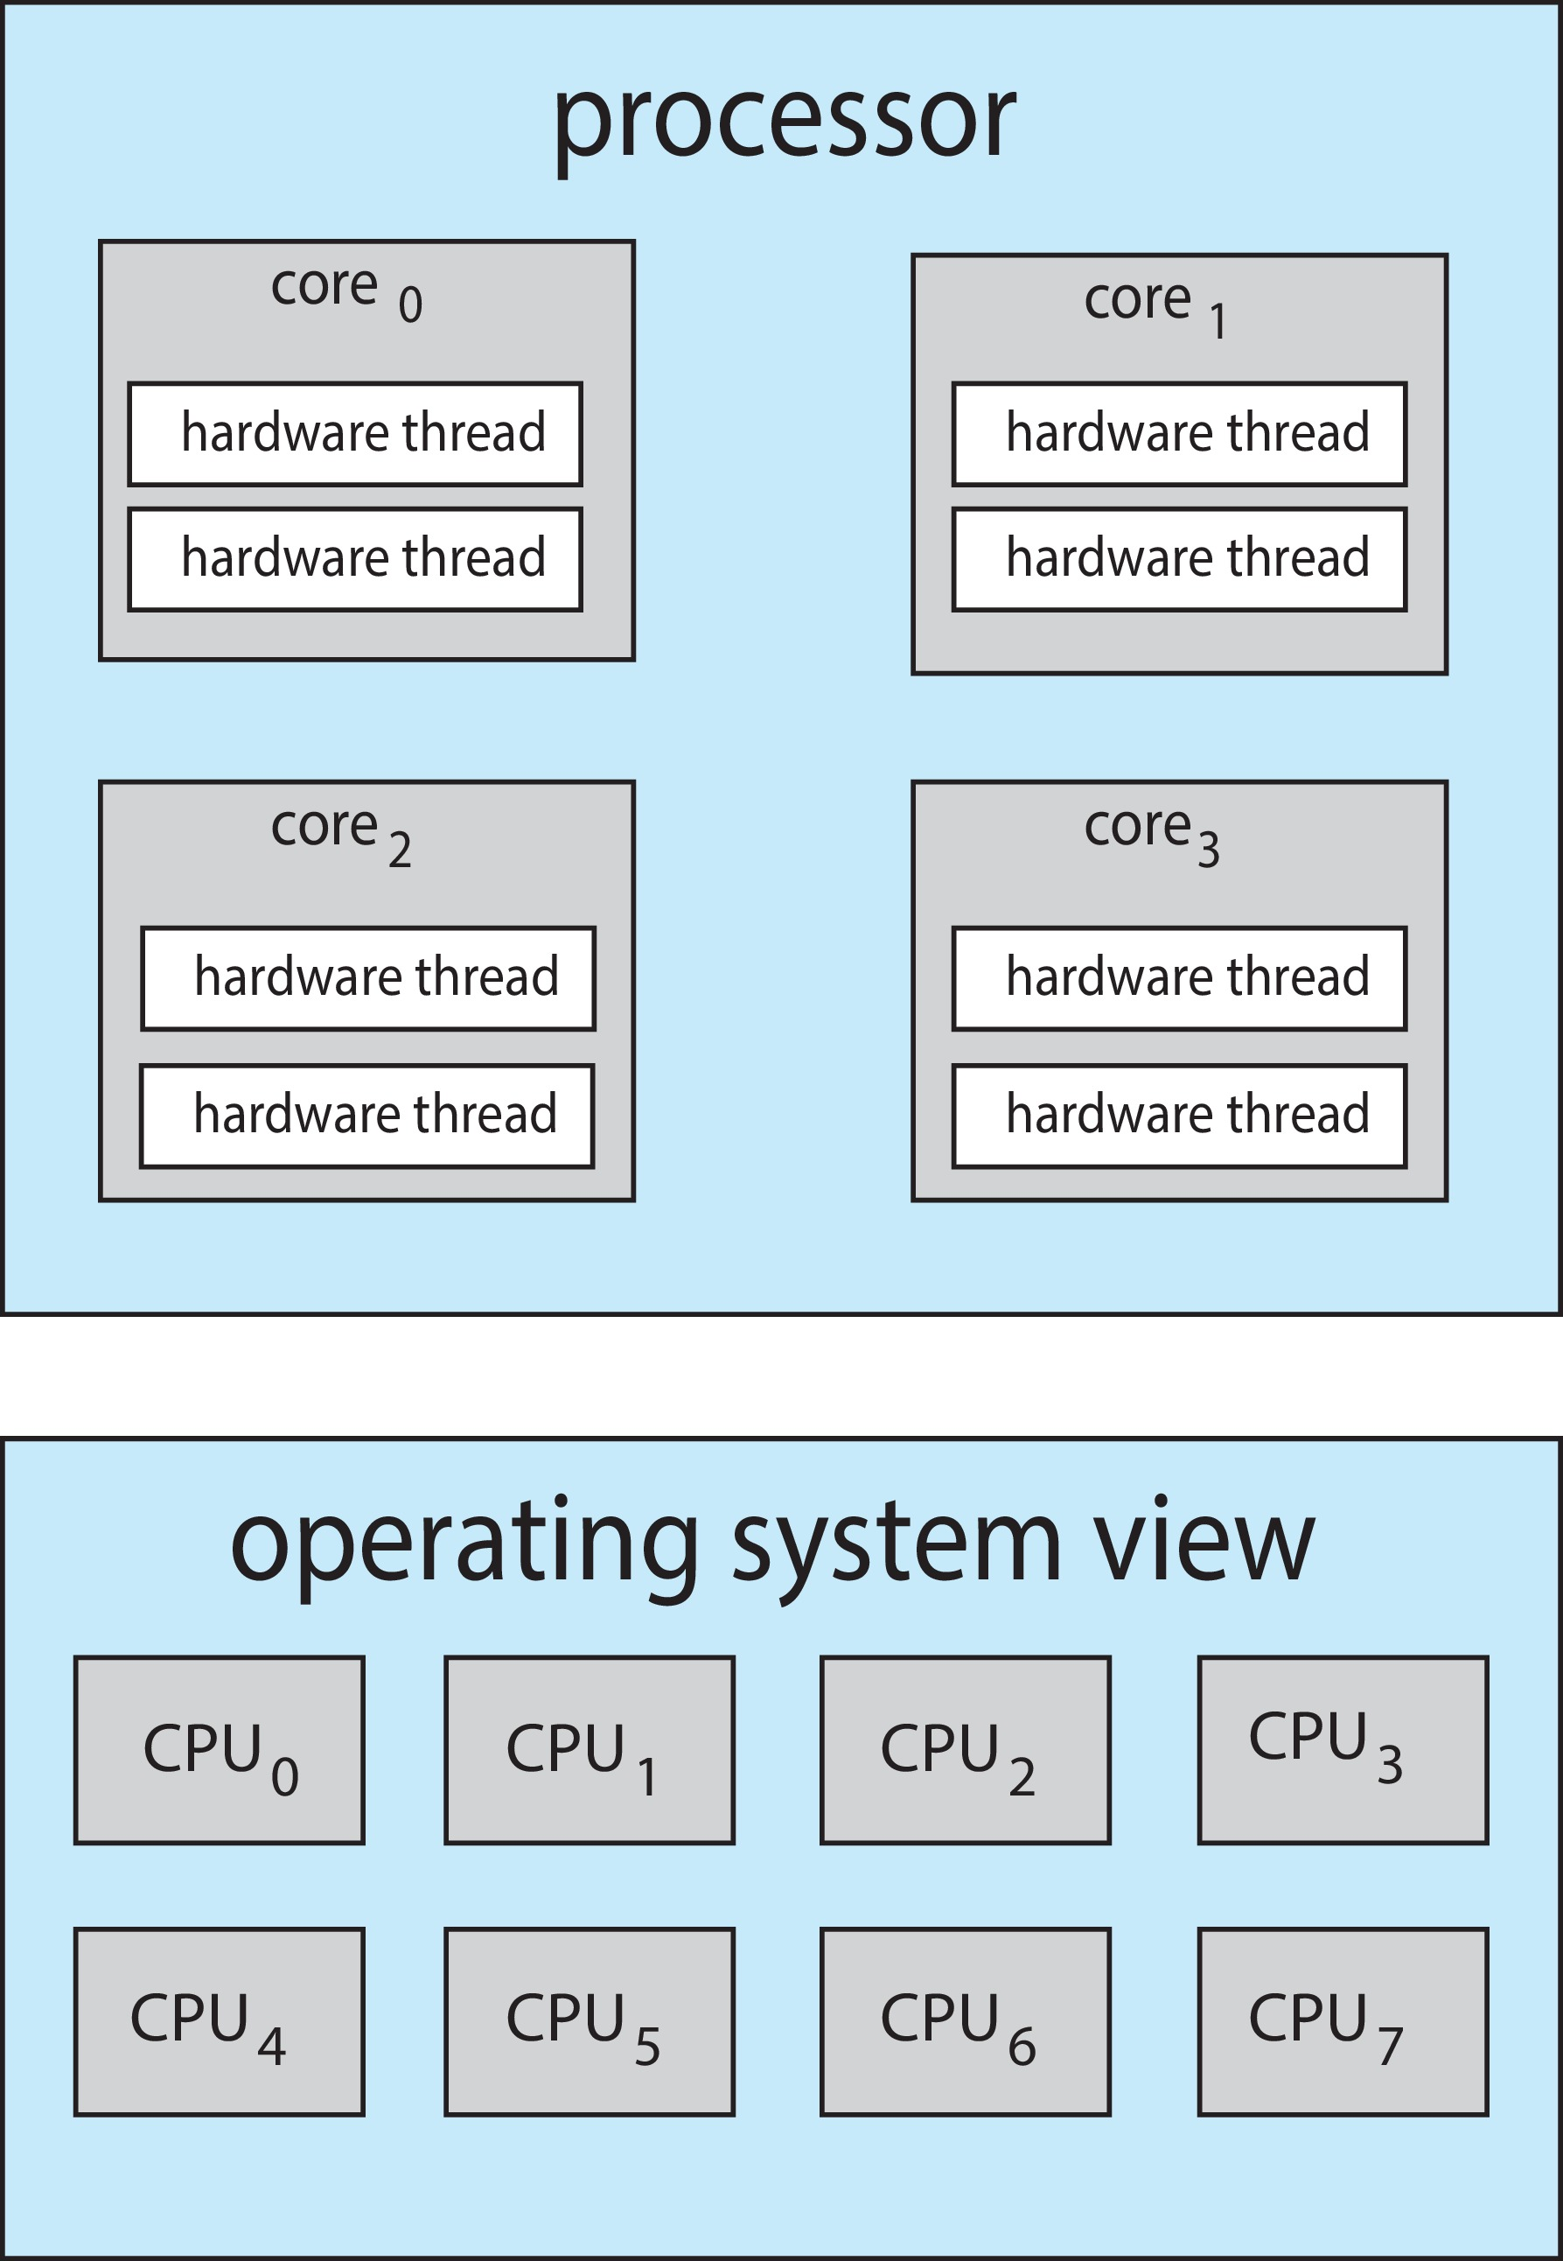
Multithreaded Multicore System
Chip-multithreading (CMT) assigns each core multiple hardware threads. (Intel refers to this as hyperthreading.)
On a quad-core system with 2 hardware threads per core, the operating system sees 8 logical processors.
Notes:
At a given time, only one hardware thread will be executed in each core.

Slide 40
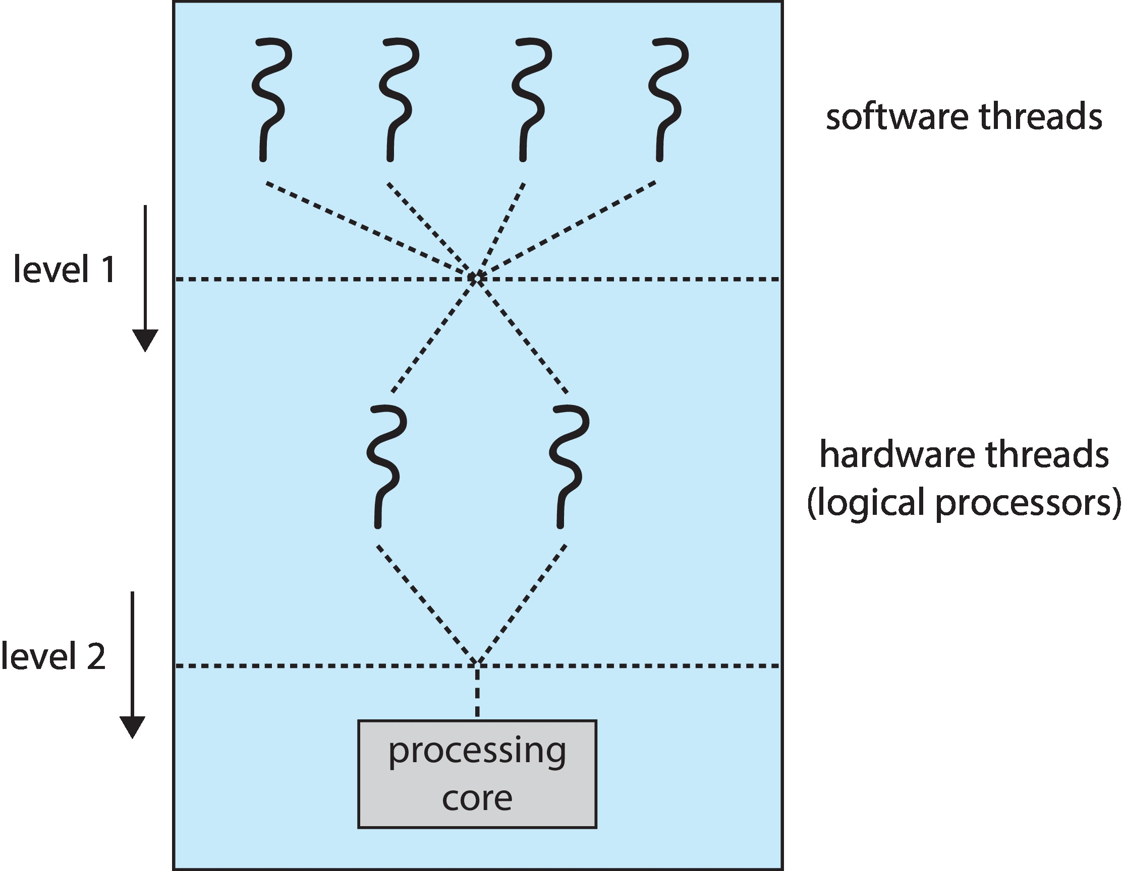
Multithreaded Multicore System
Two levels of scheduling:
The operating system deciding which software thread to run on a logical CPU
How each core decides which hardware thread to run on the physical core.
Round-Robin algorithm (UltraSPARC T3)
Assign each hardware thread a dynamic urgency value (Intel Itanium): 0-7. O: lowest, 7: highest.
Notes:
One scheduling is done by the software(User or Kernal), which is mapped to hardware threads by the hardware chip itself.
The highest urgency value hardware thread will be executed first.

Slide 41
Multiple-Processor Scheduling – Load Balancing
If SMP, need to keep all CPUs loaded for efficiency
Load balancing attempts to keep workload evenly distributed
Push migration – periodic task checks load on each processor, and if found pushes task from overloaded CPU to other CPUs
Pull migration – idle processors pulls waiting task from busy processor
Notes:
ISSUE:
We should also maintain load-balancing by moving threads between CPUs; this is done by push migration and pull migration.
There is a special program that keeps checking the load on the threads.

Slide 42
Multiple-Processor Scheduling – Processor Affinity
When a thread has been running on one processor, the cache contents of that processor stores the memory accesses by that thread.
We refer to this as a thread having affinity for a processor (i.e., “processor affinity”)
Load balancing may affect processor affinity as a thread may be moved from one processor to another to balance loads, yet that thread loses the contents of what it had in the cache of the processor it was moved off of.
Soft affinity – the operating system attempts to keep a thread running on the same processor, but no guarantees.
Hard affinity – allows a process to specify a set of processors it may run on.
Notes:
Affinity is closeness.
Ex: 1 thread executing in core0. The best way is to complete all instructions in core 0, and it does not want to move to other cores. If we want to move threads between the cores, it is expensive because we need to delete all the cache and a big process.
Load balancing says to move the threads between cores, while process affinity says to try to do it in the same core.
Default: Soft affinity.

Slide 43
NUMA and CPU Scheduling
If the operating system is non-uniform memory access (NUMA)-aware, it will assign memory close to the CPU the thread is running on.
Notes:
ISSUE:
Each CPU has its own local memory. CPU can access data from other CPU’s memory (Slow and expensive).
If a thread is executing in a CPU, the data must be stored in its own memory as much as possible.

Slide 44
Real-Time CPU Scheduling
Can present obvious challenges
Soft real-time systems – Critical real-time tasks have the highest priority, but no guarantee as to when tasks will be scheduled
Hard real-time systems – task must be serviced by its deadline
Notes:
Some tasks need to be done within a fixed time frame.
All the algorithms we learned till now do not guarantee the completion of a task in a certain amount of time. [Soft read-time systems]

Slide 45
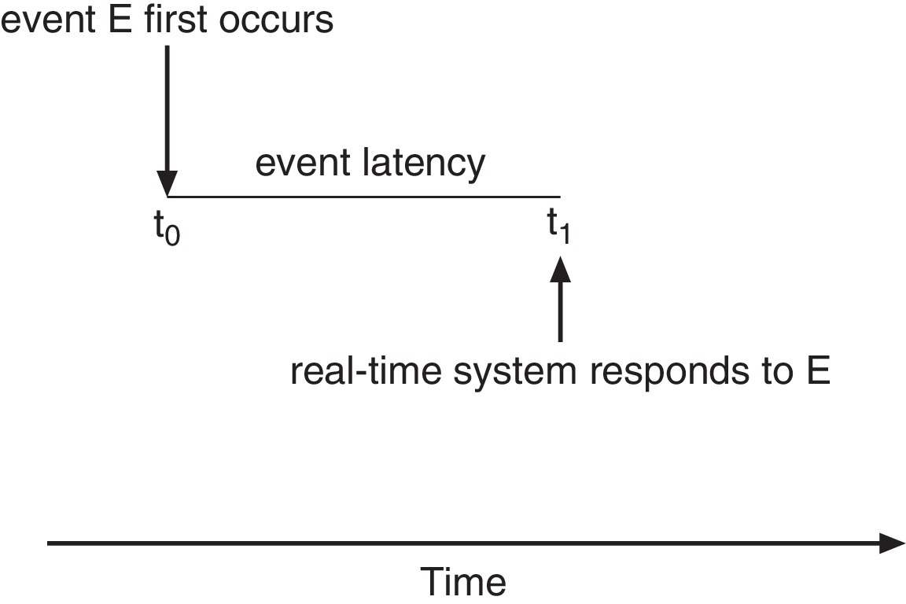
Real-Time CPU Scheduling
Event latency – the amount of time that elapses from when an event occurs to when it is serviced.
Two types of latencies affect performance
Interrupt latency – time from arrival of interrupt to start of routine that services interrupt
Dispatch latency – time for schedule to take current process off CPU and switch to another
Notes:
Interrupt latency: What type of event has occurred? – Stop what the CPU is doing and make it execute this process.
Dispatch latency: Stop the current process and execute the new process

Slide 46
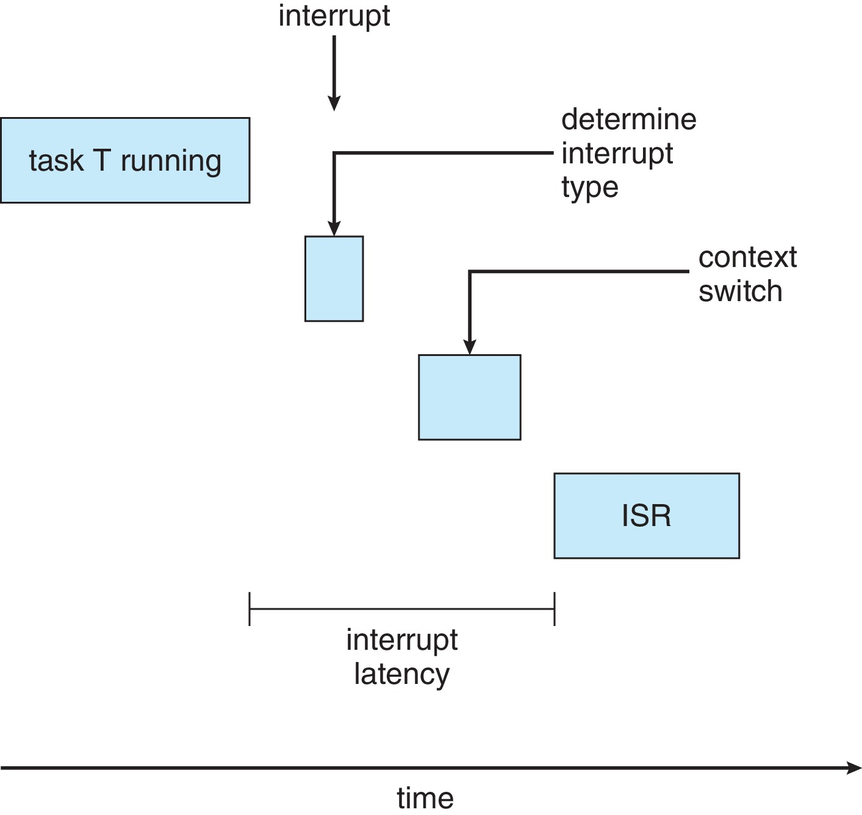
Interrupt Latency
interrupt service routine (ISR).
Notes:
1^{st,} we need to detect the type of event.
Interrupt latency: Just about to handle the event

Slide 47
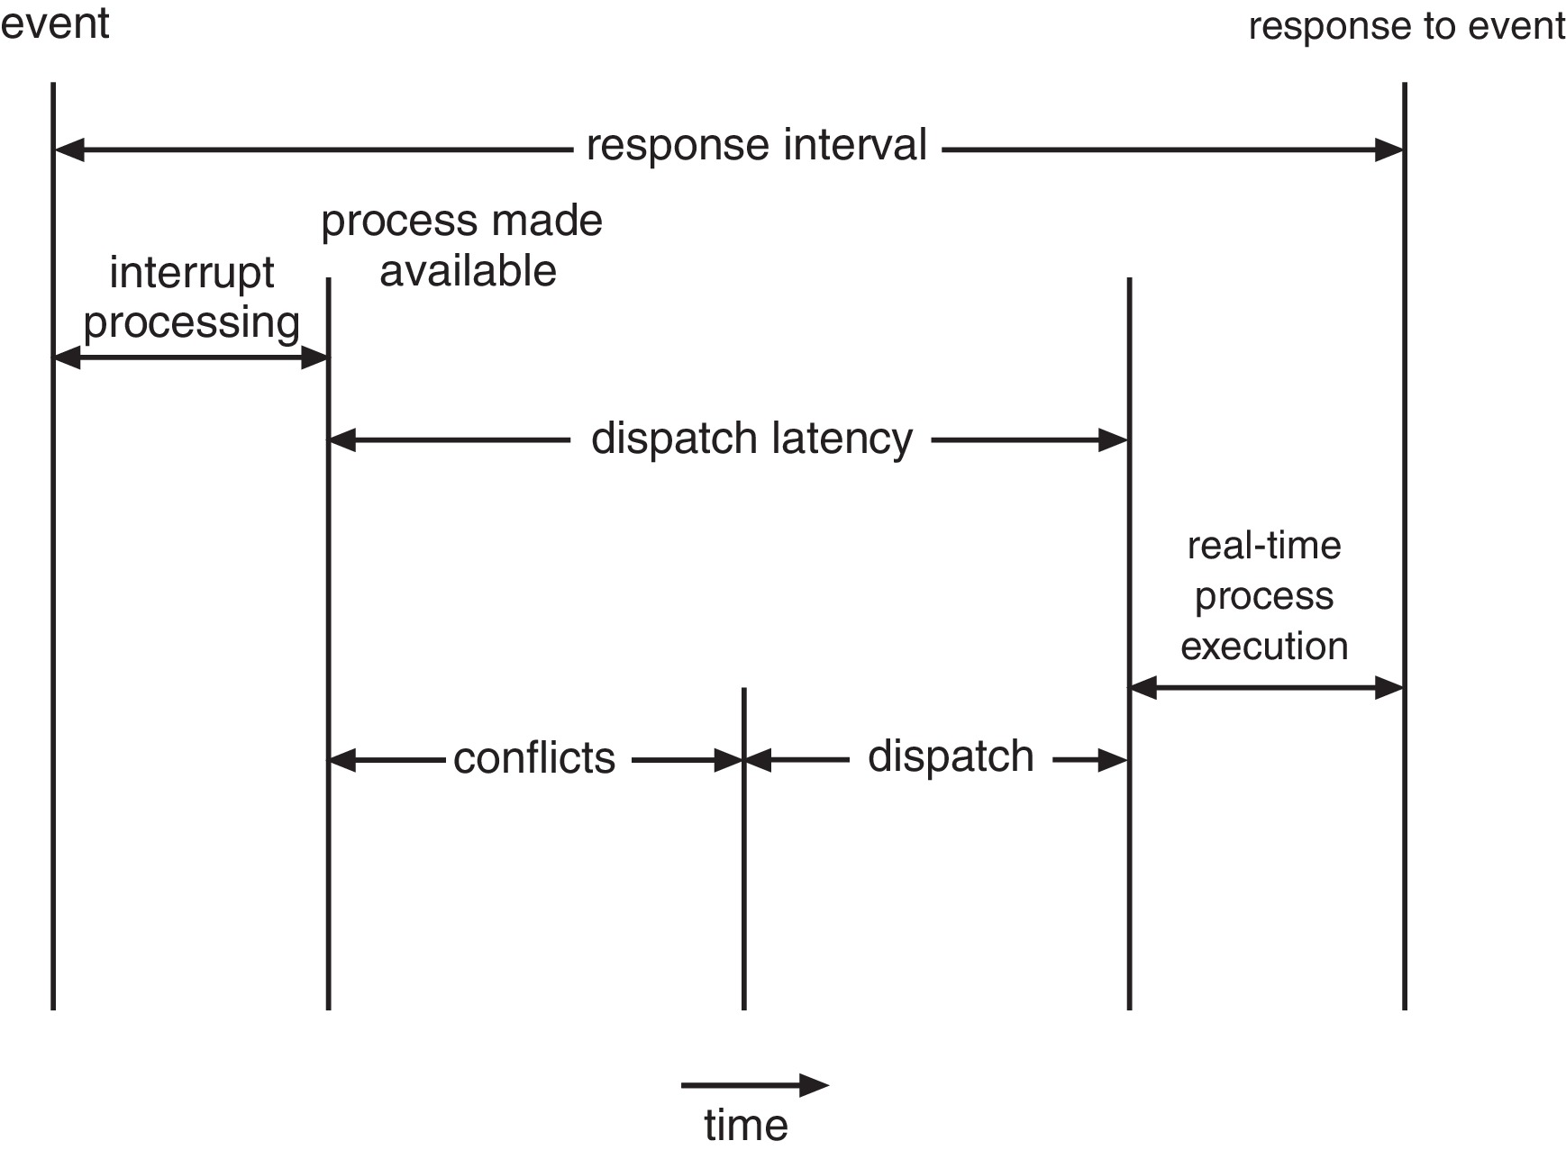
Dispatch Latency
Conflict phase of dispatch latency:
Preemption of any process running in kernel mode
Release by low-priority process of resources needed by high-priority processes
Notes:
Stop the existing process and load the new process.
Store the old process data in registers.
After a new process is executed, it goes back to execute the old process.

Slide 48
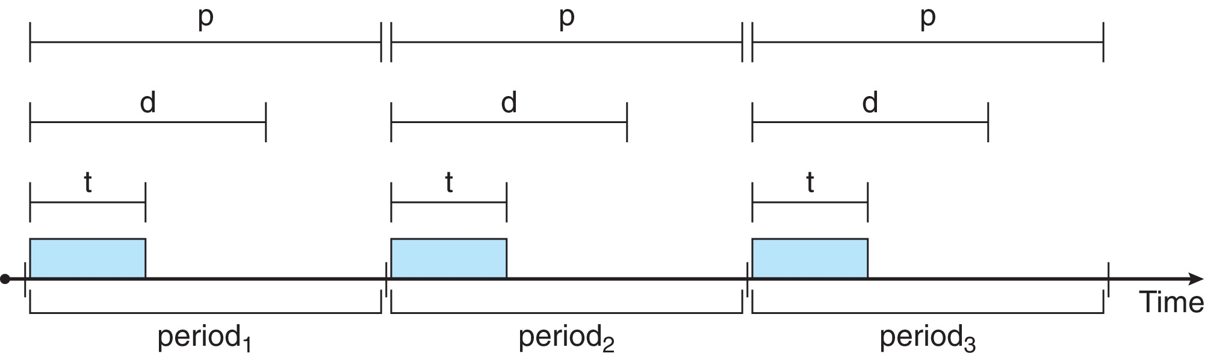
Priority-based Scheduling
For real-time scheduling, scheduler must support preemptive, priority-based scheduling
But only guarantees soft real-time
For hard real-time, must also provide ability to meet deadlines
Processes have new characteristics: periodic ones require CPU at constant intervals
Has processing time t, deadline d, period p
0 ≤ t ≤ d ≤ p
Rate of periodic task is 1/p
Notes:
We need extra information, which is the deadline for each process.
t: Actual burst time. [To execute]
Rate: If we have less periodic time, we have a high rate. We need to get CPU time more frequently.

Slide 49
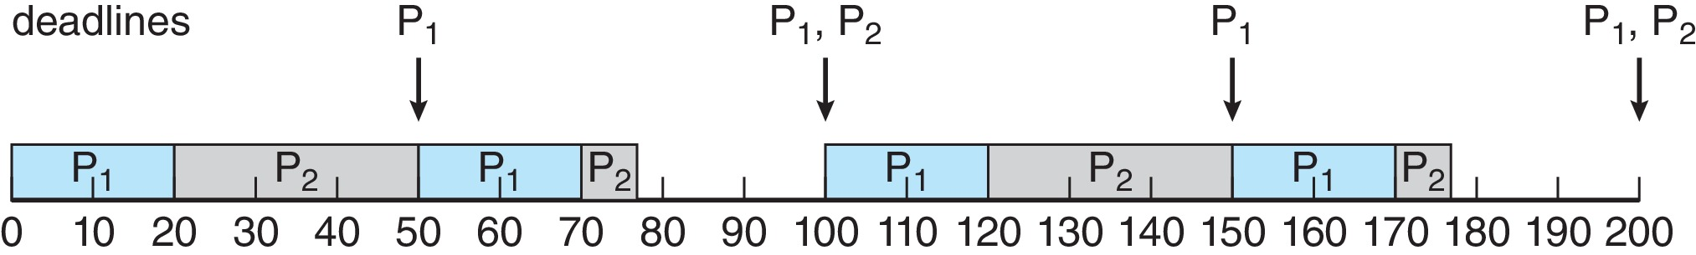
Rate Monotonic Scheduling
A priority is assigned based on the inverse of its period
Shorter periods = higher priority;
Longer periods = lower priority
Assume:
P₁ has a period of 50, a CPU burst of t₁ = 20.
P₂ has a period of 100, a CPU burst of t₂ = 35.
P₁ is assigned a higher priority than P₂.
Notes:
Monotonic: Constant
Priority will not change.
Assume the deadline and periodic time are the same.
Every period, the P2 should get 35. and P1 should get 20 in every period.
The new period is 50 for P1. Till 50, P2 needs 35, but it completed only 30. So P2 is preempted(Stopped) at 50.

Slide 50
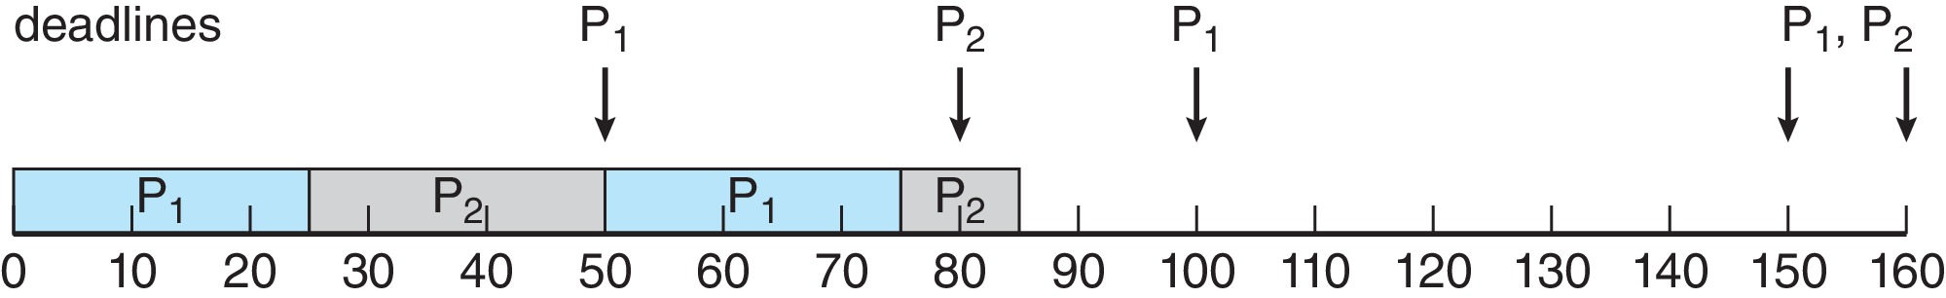
Missed Deadlines with Rate Monotonic Scheduling
Assume:
P₁ has a period of 50, a CPU burst of t₁ = 25.
P₂ has a period of 80, a CPU burst of t₂ = 35.
Process P₂ misses finishing its deadline at time 80
Notes:
The P2 deadline is crossed.
P2 cannot be used in this rate of monotonic scheduling.

Slide 51
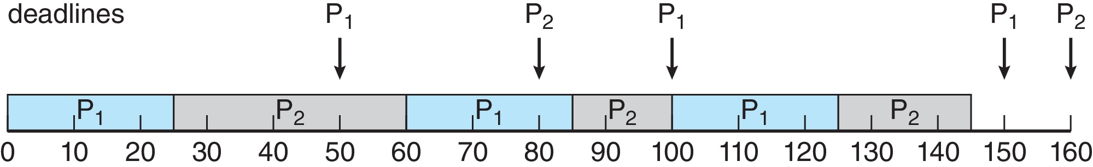
Earliest Deadline First Scheduling (EDF)
Priorities are assigned according to deadlines:
The earlier the deadline, the higher the priority
The later the deadline, the lower the priority
Again assume:
P₁ has a period of 50, a CPU burst of t₁ = 25.
P₂ has a period of 80, a CPU burst of t₂ = 35.
Notes:
Dynamic priority.

Slide 52
Proportional Share Scheduling
T shares are allocated among all processes in the system
An application receives N shares where N < T
This ensures each application will receive N / T of the total processor time
Example: assume that a total of T = 100 shares is to be divided among three processes, A, B, and C.
A is assigned 50 shares, B is assigned 15 shares, and C is assigned 20 shares.
This scheme ensures that A will have 50 percent of total processor time, B will have 15 percent, and C will have 20 percent.
Notes:
Assume that we have T shares (Resources) allocated based on the number of shares applied to applications.
Who assigns these shared? OS or programmer explicitly.

Slide 53
POSIX Real-Time Scheduling
Extension to the POSIX for real-time computing: POSIX.1b standard.
API provides functions for managing real-time threads
Defines two scheduling classes for real-time threads:
SCHED_FIFO - threads are scheduled using a FCFS strategy with a FIFO queue. There is no time-slicing for threads of equal priority
SCHED_RR - similar to SCHED_FIFO except time-slicing occurs for threads of equal priority
Defines two functions for getting and setting scheduling policy:
pthread_attr_getsched_policy(pthread_attr_t *attr, int *policy)
pthread_attr_setsched_policy(pthread_attr_t *attr, int policy)

Slide 54
POSIX Real-Time Scheduling API
#include <pthread.h>
#include <stdio.h>
#define NUM_THREADS 5
int main(int argc, char *argv[])
{
int i, policy; pthread_t_tid[NUM_THREADS];
pthread_attr_t attr;
/* get the default attributes */
pthread_attr_init(&attr);
/* get the current scheduling policy */ if (pthread_attr_getschedpolicy(&attr, &policy) != 0)
fprintf(stderr, "Unable to get policy.\n");
else {
if (policy == SCHED_OTHER) printf("SCHED_OTHER\n");
else if (policy == SCHED_RR) printf("SCHED_RR\n");
else if (policy == SCHED_FIFO) printf("SCHED_FIFO\n");
}
Notes:
Other could be anything – Priority, SJF, etc.

Slide 55
POSIX Real-Time Scheduling API (Cont.)
/* set the scheduling policy - FIFO, RR, or OTHER */ if (pthread_attr_setschedpolicy(&attr, SCHED_FIFO) != 0)
fprintf(stderr, "Unable to set policy.\n");
/* create the threads */ for (i = 0; i < NUM_THREADS; i++)
pthread_create(&tid[i],&attr,runner,NULL);
/* now join on each thread */ for (i = 0; i < NUM_THREADS; i++)
pthread_join(tid[i], NULL);
}
/* Each thread will begin control in this function */
void *runner(void *param) {
/* do some work ... */
pthread_exit(0);
}

Slide 56
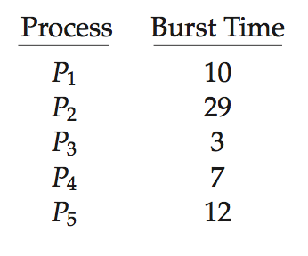
Algorithm Evaluation
How to select CPU-scheduling algorithm for an OS?
Determine criteria, then evaluate algorithms
Deterministic modeling
Type of analytic evaluation
Takes a particular predetermined workload and defines the performance of each algorithm for that workload
Consider 5 processes arriving at time 0:
Notes:
A simple way is to make sure, before we test, that we use the same input data/testing data for all algorithms.
Why 5 processes only, why not 100?
We can change the load.
Use this in PROJECT_1

Slide 57
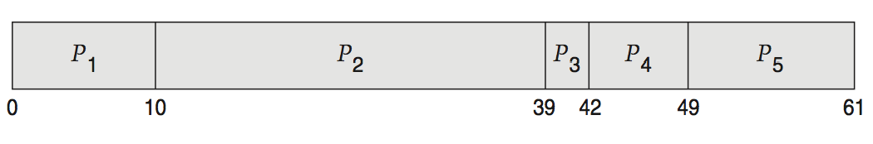
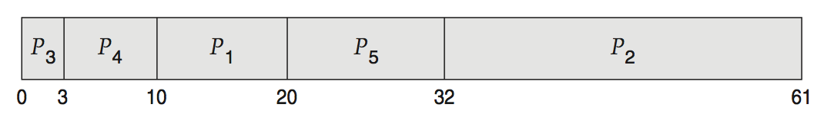
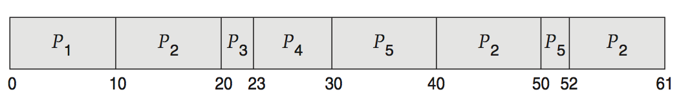
Deterministic Evaluation
For each algorithm, calculate minimum average waiting time
Simple and fast, but requires exact numbers for input, applies only to those inputs
FCS is 28ms:
Non-preemptive SJF is 13ms:
RR is 23ms:
Notes:
Important for EXAM

Slide 58
Queueing Models
Describes the arrival of processes, and CPU and I/O bursts probabilistically
Commonly exponential, and described by mean
Computes average throughput, utilization, waiting time, etc.
Computer system described as network of servers, each with queue of waiting processes
Knowing arrival rates and service rates
Computes utilization, average queue length, average wait time, etc.
Notes:
Another technique of evaluation.
Indirectly computing waiting time, not directly.
If we need service, we need to request which is in the queue. [Kind of client-server]

Slide 59
Little’s Formula
n = average queue length
W = average waiting time in queue
λ = average arrival rate into queue
Little’s law – in steady state, processes leaving queue must equal processes arriving, thus: n = λ x W
Valid for any scheduling algorithm and arrival distribution
For example, if on average 7 processes arrive per second, and normally 14 processes in queue, then average wait time per process = 2 seconds
Notes:
λ: How many processes are coming into the queue every second?
Better than deterministic evaluation.

Slide 60
Simulations
Queueing models are limited
Simulations more accurate
Programmed model of computer system
Clock is a variable
Gather statistics indicating algorithm performance
Data to drive simulation gathered via
Random number generator according to probabilities
Distributions defined mathematically or empirically
Trace tapes record sequences of real events in real systems
Notes:
Better than Little’s formula.
Mimic a computer system.

Slide 61
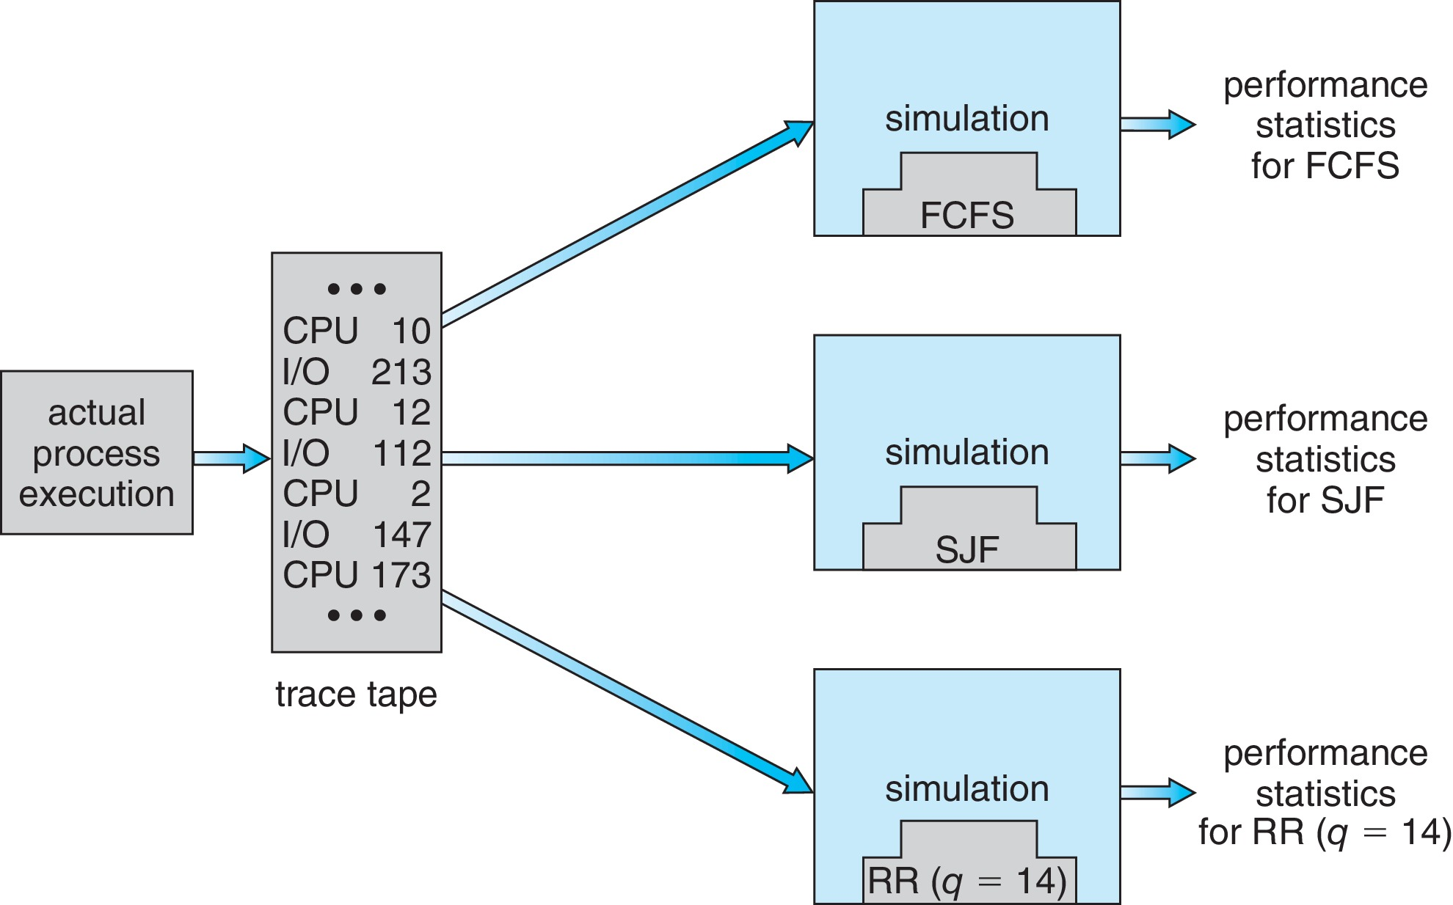
Evaluation of CPU Schedulers by Simulation
Notes:
Actual process: Chrome browser, outlook, etc.

Slide 62
Implementation
Even simulations have limited accuracy
Just implement new scheduler and test in real systems
High cost, high risk
Environments vary
Most flexible schedulers can be modified per-site or per-system
Or APIs to modify priorities
The downfall of this approach is that the performance-tuning a system or application most often does not result in improved performance in more general situations.
Notes:
The best way is to implement by ourselves.
Problems/Risks: High cost, more time, high risk, environment vary.
Administrators should be able to change the scheduler dynamically.

Slide 63
Further Reading
Operating System Examples
Refer to Section 5.7 of the textbook.
Linux scheduling
Windows scheduling
Solaris scheduling

